Slide 1


Types of Lathe
Workshop Practices
20CSE1030

Slide 2
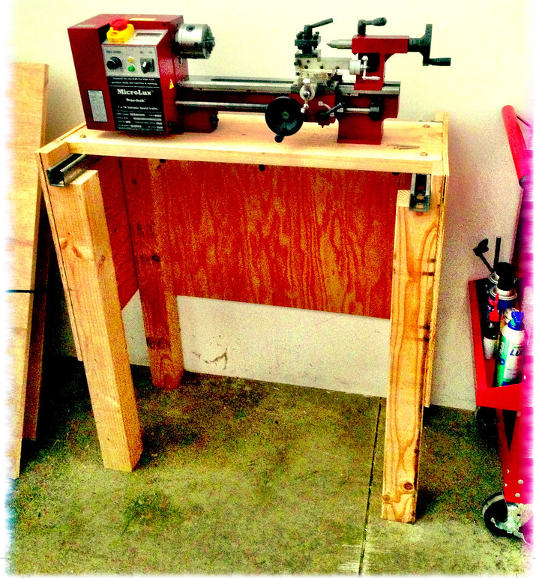

Bench Lathe
A bench lathe is a material reduction machine built into a bench or worktable
A lathe takes a solid block of a material and reduces it to create a symmetrical item. Using a bench lathe, you can cut, knurl, drill, or sand material down to create a new object
Attached to the bench lathe is a spindle. This hollow bar runs parallel to the bed and is used to attach accessories. These accessories secure the workpiece in place.
On a bench lathe, the spindle moves the block of material with either an electric motor or foot power.
Notes:
Notes to presenter:
Description of what you learned in your own words on one side.
Include information about the topic
Details about the topic will also be helpful here.
Tell the story of your learning experience. Just like a story there should always be a beginning, middle and an end.
On the other side, you can add a graphic that provides evidence of what you learned.
Feel free to use more than one slide to reflect upon your process. It also helps to add some video of your process.

Slide 3
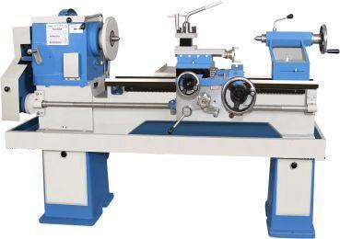

Tool Room Lathe
A tool room lathe is generally a high precision lathe having a gearbox in the headstock offering a extended range of thread pitches and feeds.
It has a low spindle runout and precision guideway and leadscrews offering high stability, low clearances and backlash
It is used for making precision components in the tool room.
Notes:
Notes to presenter:
Description of what you learned in your own words on one side.
Include information about the topic
Details about the topic will also be helpful here.
Tell the story of your learning experience. Just like a story there should always be a beginning, middle and an end.
On the other side, you can add a graphic that provides evidence of what you learned.
Feel free to use more than one slide to reflect upon your process. It also helps to add some video of your process.

Slide 4
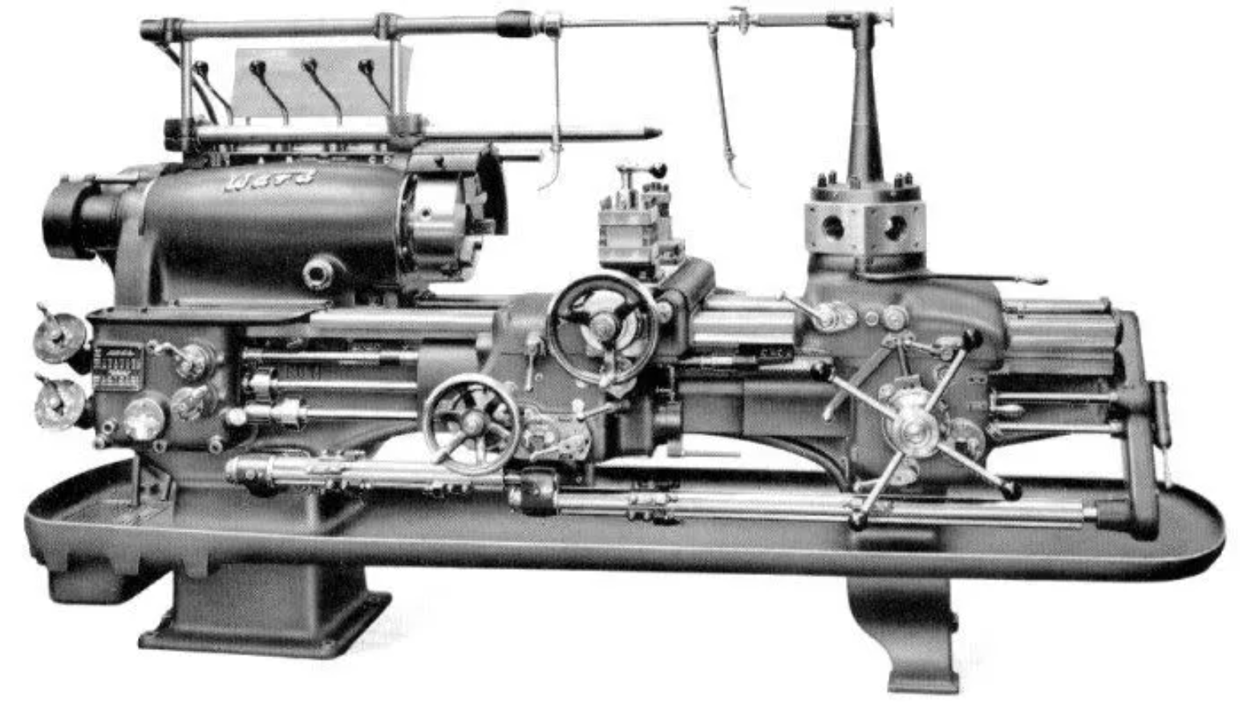
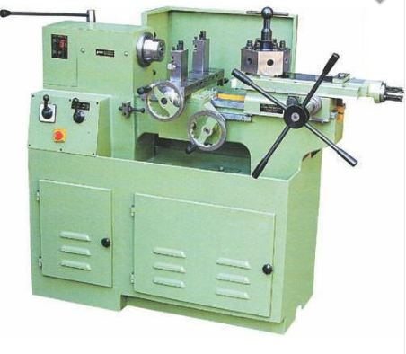
Turret & Capstan Lathe
Turret Lathe
Capstan Lathe
The turret head is directly mounted on the saddle and the saddle slides over the bed ways.
Turret Lathe is a heavy weight machine and the saddle is moved along with the turret head during machining.
Power operated Jaw chunks are used to hold the work piece.
Turret lathe is used for the mass production of large size equal parts.
The Turret tool head is mounted over the ram and the ram is mounted on the saddle.
Capstan lathe is a light weight machine and the saddle is fixed during machining.
Hand operated collect chucks are used to hold the work piece.
Capstan lathe is used in the mass production of small size equal part.

Slide 5
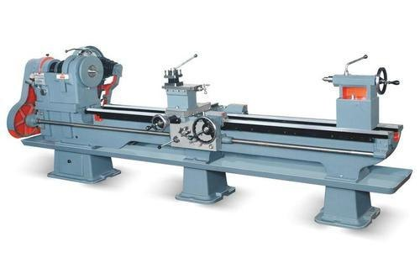
Special Purpose Lathe Machine
These lathes are used for special purposes such as heavy-duty production of identical parts.
In addition, these lathes also perform specific functions that cannot be performed by the standard lathes
Few of the special purpose lathe are:
Precision Lath; Facing Lathe; Frontal Lathe; Vertical Lathe; Crankshaft Lathe;
Production Lathe; Duplicate Lathe; Screw cutting Lathe
They are more efficient and effective in what they do.

Slide 6
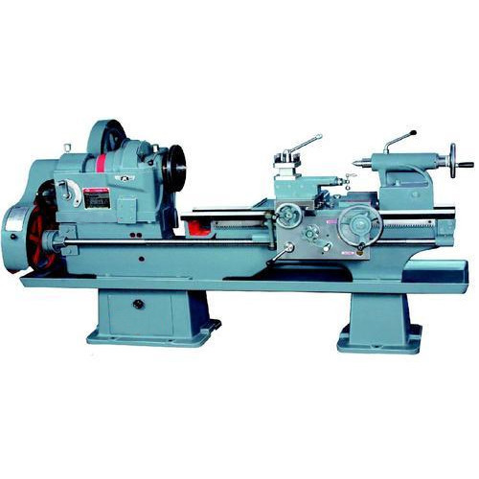
Automatic Lathe
An Automatic lathe is a lathe with an automatically controlled cutting process.
Automatic lathes perform all operating cycles automatically. They are used for the mass production of simple workpieces such as bolts, screws, nuts and bushings
All movements of cutting tools, their sequence of operations, appilcations, feeding of raw materials, parting off, unloading of finished parts are all done on machine.
This lathe is also known for its high accuracy.

Slide 7

Thank You

